Slide 1
AUTOMATIC ATTENDANCE SYSTEM USING FACE RECOGNITION
MINI PROJECT
-FINAL REVIEW

Slide 2
TEAM-2
18K41A0502 DHARANI.A
18K41A0538 LOKESHWAR.A
18K41A0545 MALAVIKA.R
18K41A0556 SRI ABHINAY.K

Slide 3
Introduction
Automatic attendance system is to take attendance using face recognition .
In this system, we capture the different angle images of registered students.
It almost captures around 60 pictures of each student.
All the captured images further trained using machine learning algorithms.
We have many other alternative proposed products, but in this pandemic situation, face recognition is best.

Slide 4
About Proposed System
Firstly , we need to collect the images of all students (registration process).
Afterwards , we need to train all the captured pictures.
For training images, we used a built-in machine learning classifier(haar_cascade_classifier).
All these trained images are saved in XML format . Name, roll number, Date and Timings of all students are stored in an excel sheet.
It tracks the pictures and compares them with the images present in the database.
The attendance of every student is gathered in an excel sheet. After the class the faculty can refer the excel sheet.

Slide 5
LIBRARIES USED IN THE SYSTEM
OPENCV
NUMPY
PANDAS
CSV
Datetime
Tkinter

Slide 6
OpenCV
OpenCV is a machine learning software library.
OpenCV is cross-platform which is used for developing real-time computer vision applications.
It is used for Image processor, video analysis, pattern recognition, and detecting objects.
Using OpenCV, we can turn on our desktop camera and capture the videos.
OpenCV provides a pre-trained classifier it has the chain of haar feature that is the best match for the fontal face.

Slide 7
Numpy, Pandas, CSV and Datetime
Numpy is a Python library used for working with arrays. It consists of multidimensional array objects and performs mathematical and logical operations on arrays.
Pandas library is used for data manipulation, analysis, and also the creation of data frames.
CSV is a simple file format for storing and retrieving the data from the file. Each line of the file is a data record.
Datetime library is used to retrieve the current date and time to store in a CSV file.

Slide 8
Tkinter
This is a python GUI application. It has a package/module where we can perform GUI programming.
Here, we use Tk() class for creating the window.
Using label, dialog box, buttons, grids, FG, background color, and text we, can design a GUI application.
We can bind functions and events using the command.

Slide 9
Algorithms & Classifiers used:
Local Binary Patterns Histograms (LBPH).
Haar_casacade_classifier

Slide 10
Local Binary Patterns Histograms (LBPH)-About LBP Operation
It is used for face/Image representation. If the image is in grayscale, we can use 3X3 pixels. It represents a 3X3 matrix containing the intensity of each pixel (0~255). Here we consider center value as a threshold. And process this for extracting the LBP code.
This process involves thresholding the center pixel with the surrounding pixel values using window mean and considers the result as a binary number.
This process can be done in two ways- By comparing the neighbor pixels with center pixels and, the next one is using the formula
LBP=Σn=0 s(in-ic)2^n
s(z)={1 z>=0 , 0 z<0}
Afterward, we need to write binary format and get the LBP code.

Slide 11
Haar_casacade_classifier
Haar_casacade_classifier is an algorithm it cascades eventually down into a square. Haar features are rudimentary building block- edge features, line features, four rectangular features.
They find face by layering these haar features, after if the layering we get the correct match of the face.
Haar_casacade classifier has all the positive and negative images.
Haar_casacade_classifier already trained images using this we can detect the images.

Slide 12
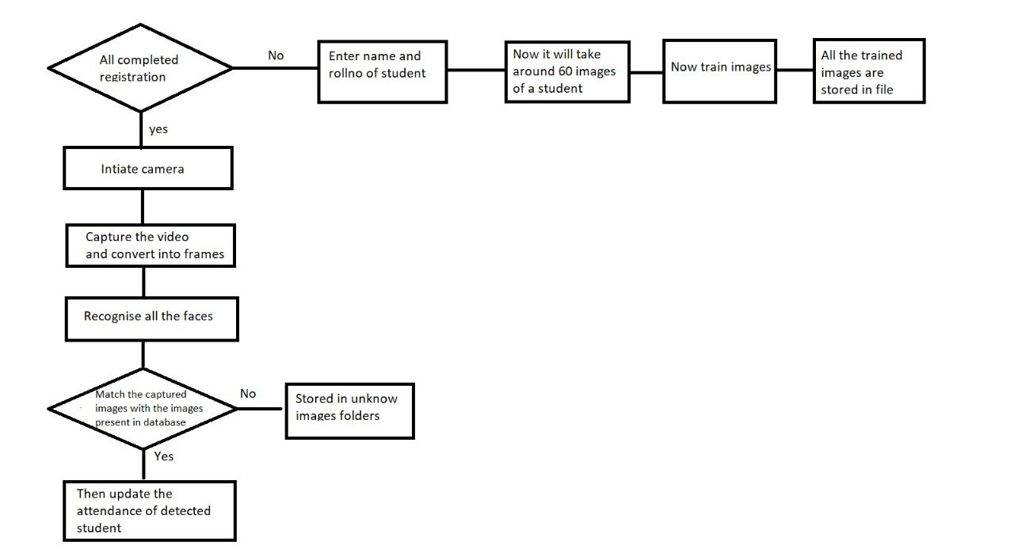
Methodology

Slide 13
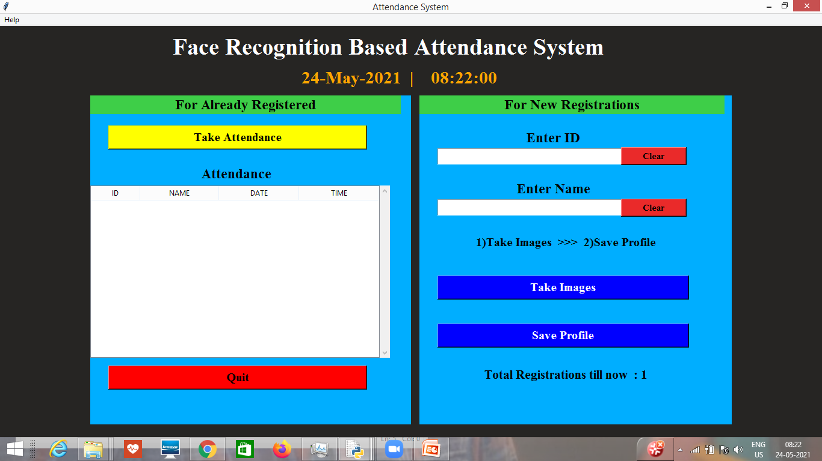
Process of proposed system
Here, we use a GUI application to collect the information from the user and do certain operations.

Slide 14
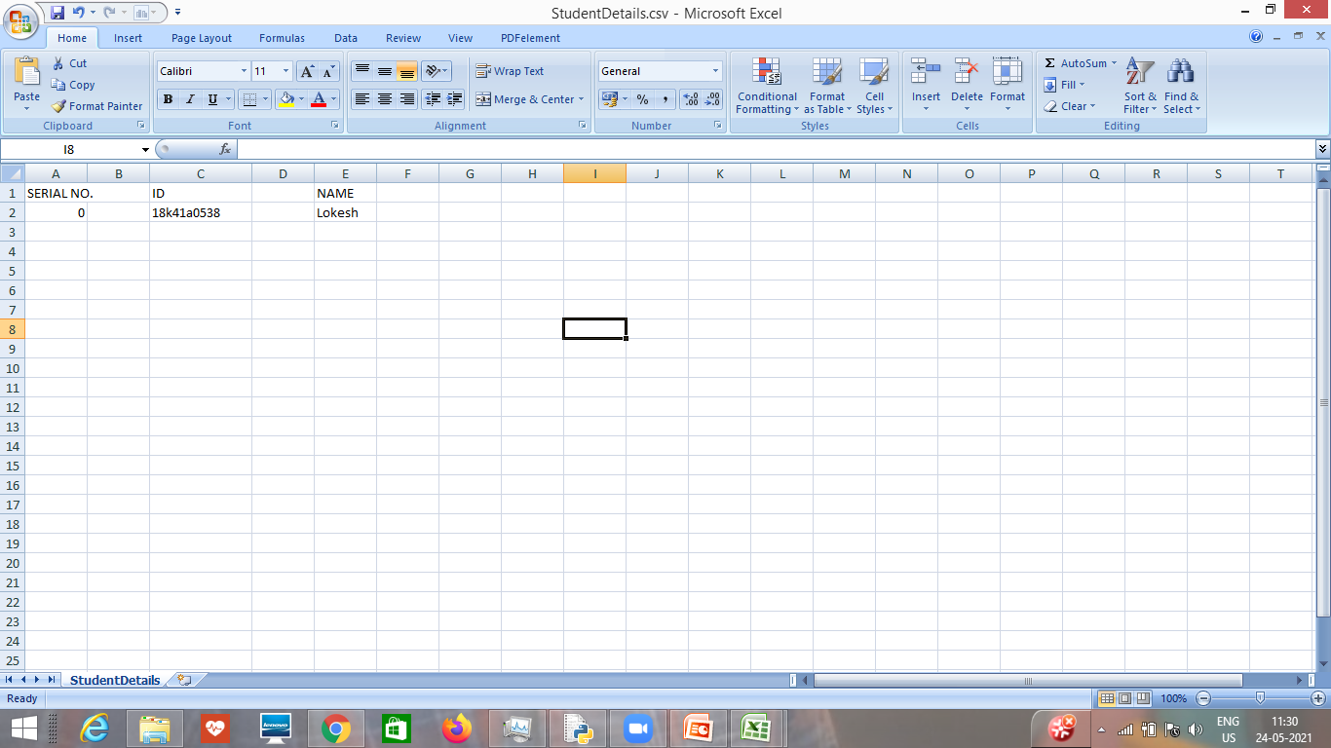
After entering the name and ID, the details will be stored in one folder.
Student details folder: It contains an excel file, in which you will have the details of all the students who have registered.

Slide 15
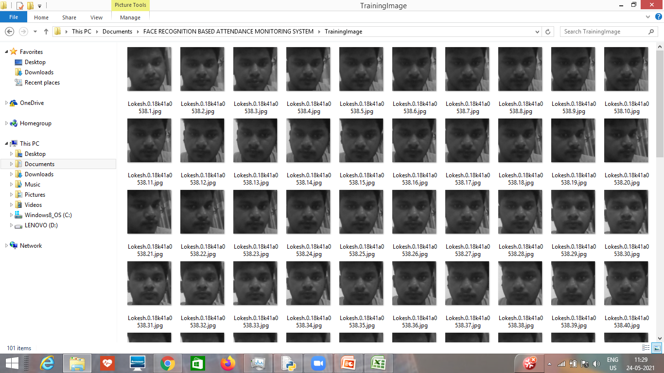
All the captured images are stored in a folder. Training Image folder: It has around 60 images of a single person from different angles.

Slide 16
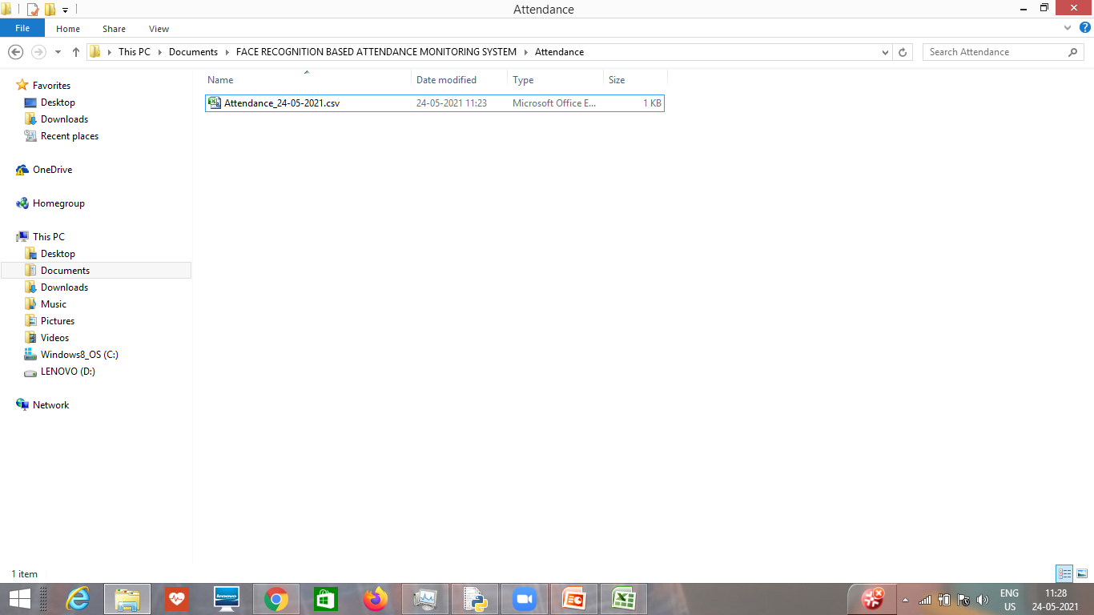
Attendance folder: This will have the final excel sheet which will have the attendance mark for all the students. Here, in this folder attendance sheets will be stored with date and time.

Slide 17
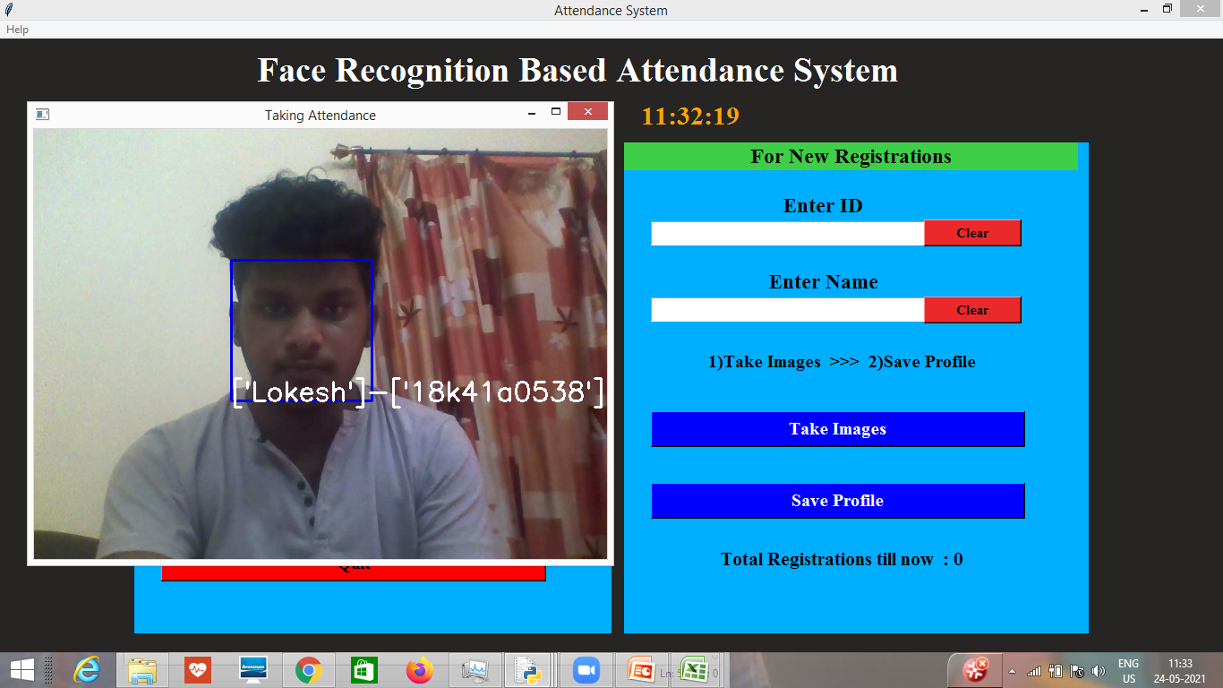
Face Recognition:
Now, we need to click on the train image. Afterward, we need to track the images. The attendance is marked for the detected face.
We can see a rectangle around faces and their id and name are displayed with the percentage.

Slide 18
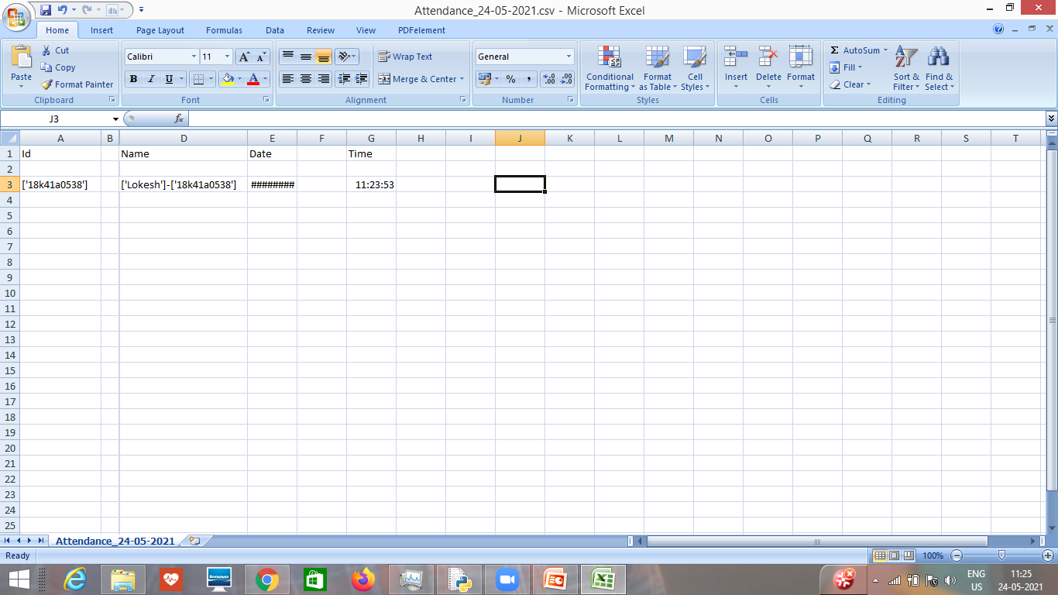
Attendance Updation: After the face recognition process, the recognized faces will be marked as present in the attendance folder in excel sheets with their Id, name, date, time and the rest of the students will be marked as absent.

Slide 19
Conclusion
Using this technique, faculty can’t take additional time on taking attendance.
And they may be fewer chances of proxy.
So, the proposed system will support the performance of existing student’s attendance system in the following ways:
1. Minimizing the time required for marking attendance and maximizing the time required for actual teaching process.
2. Increase the efficiency of the overall system.
3.Improving the security, hence attendance will do without even the students knowing.

Slide 20
THANK YOU

